Slide 1
Improving coverage and capacity in cellular System
Constantly there is a rise in demand for wireless service
Need to have more channels per coverage area
How do we do?
Use of techniques to expand the capacity of cellular systems
Cell Splitting
Cell Sectoring
Microcell zone concept

Slide 2
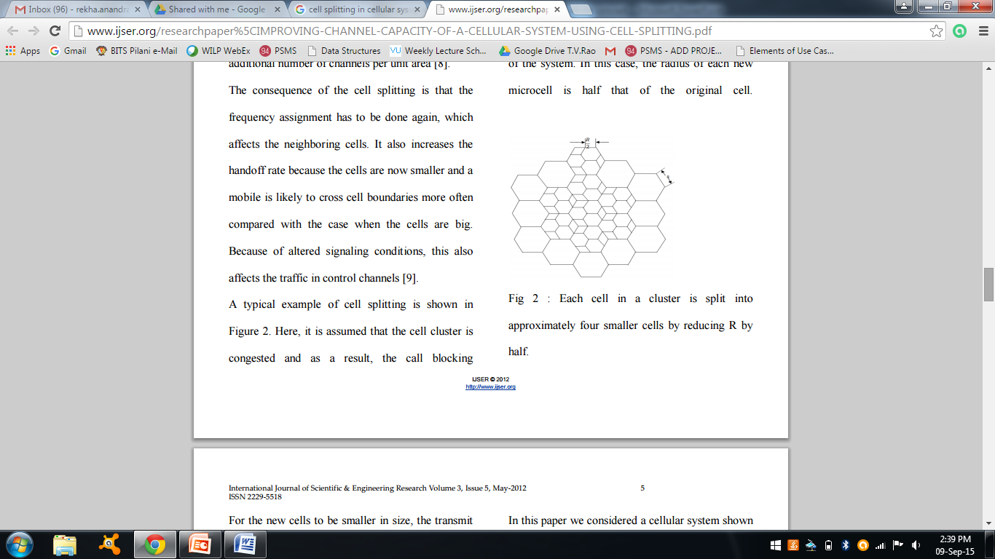
Improving coverage and capacity in cellular System
Cell Splitting (re-scaling of the system)
Cell splitting is the process of subdividing a congested cell into smaller cells.
Cell splitting increases the capacity of a cellular system since it increases the number of times that channels are reused.
Microcell
Fig: Illustration of cell splitting
Courtesy to T G palanivelu and R Nakkeeran
©2009 PHI Learning Limited,Delhi

Slide 3
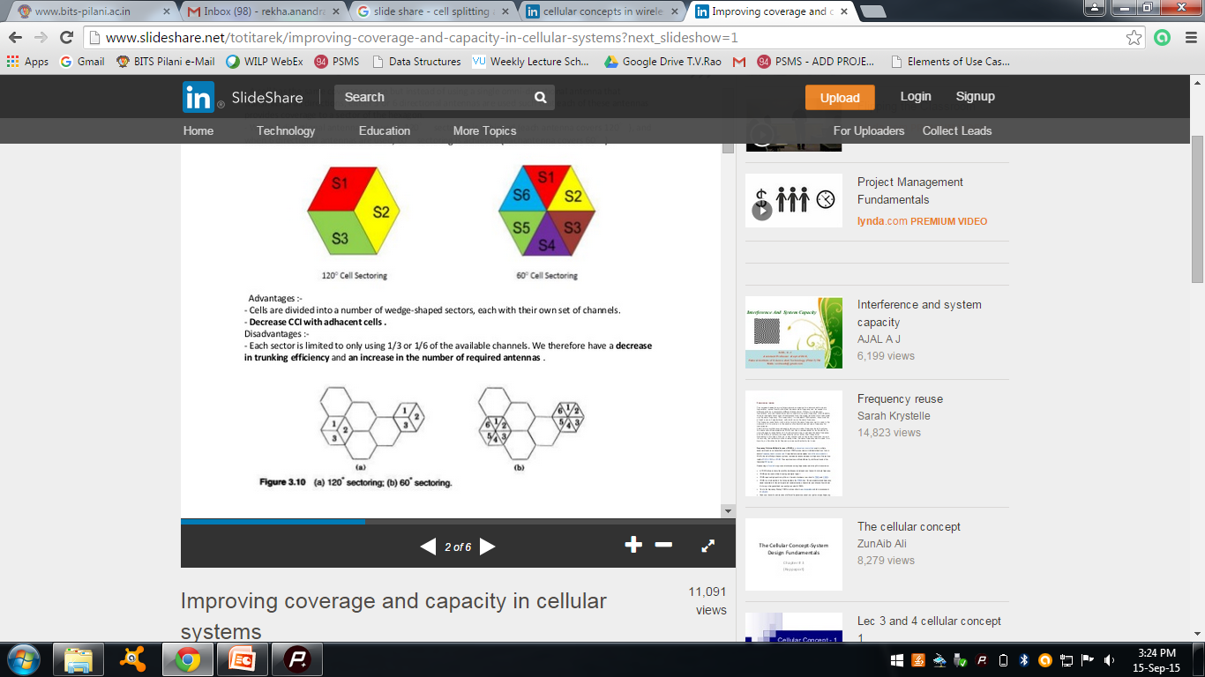
Cell Sectoring
The co-channel interference may be decreased by replacing the single omni directional antenna by several directional antennas, each radiating with in a specified sector. A Cell has same coverage area space.
A cell is normally partitioned into three 120⁰ sectors or six 60⁰ sectors.
Fig: Illustration of cell sectoring
Courtesy to Theodore S. Rappaport
©2002, 1996 Prentice Hall PTR

Slide 4
Cell Sectoring
Advantages:
Cells are divided into a number of wedge shaped sectors, each with their own set of channels.
Decrease in CCI.
Disadvantages:
Each sector is limited to only using 1/3 or 1/6 of the available channels. Therefore decrease in trunking efficiency.
Increase in the number of required antenna.
Antennas are expensive , have to be maintained.
Increased number of Handoffs (sector to sector)

Slide 5
Microcell Zone concept
A cell is divided into microcells or zones.
Each microcell is connected to the same base station.
Each zone uses a directional antenna.
As a mobile travels from one zone to another, it retains the same channel. i.e no hand off.
MS is served by the strongest zone.

Slide 6
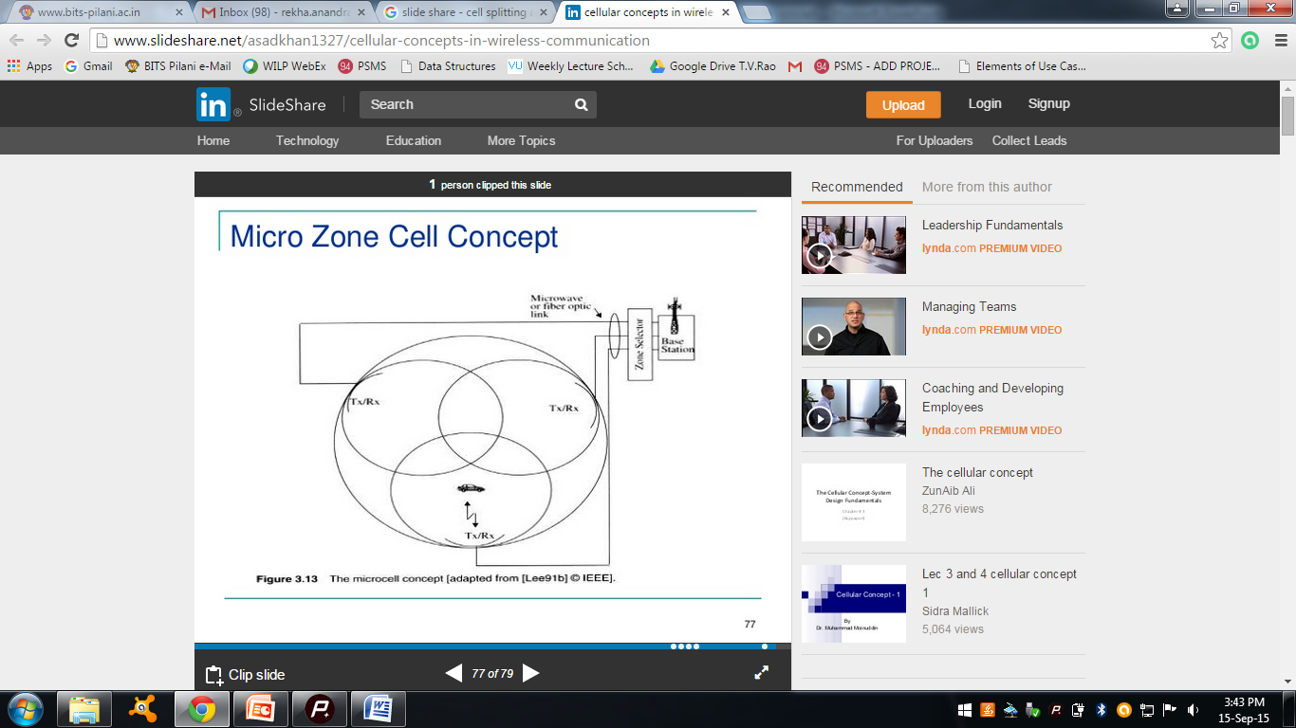
Microcell Zone Concept
Fig: The Microcell Concept

Slide 7
Repeaters for Range Expansion
Radio Re-transmitters are called Repeaters.
Used in hard to reach areas such as valleys, tunnels etc.
A repeater consists of a radio receiver, an amplifier ,a transmitter.
Repeaters are bidirectional
Receive signals from the base station,
Amplify the signals and
Re-radiate the signals.

Slide 8
Summary
In order to improve the coverage and capacity of the cellular systems many techniques sectoring, cell splitting and microcell zone concept .
Repeaters are used in hard to reach areas and also for range extension .

